Slide 1
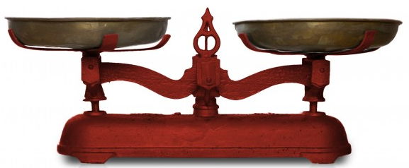
Algorithmic Puzzle:
Find a fake coin among eight coins
There are eight identical-looking coins; one of these coins is counterfeit and is known to be lighter than the genuine seven coins.
What is the minimum number of weighings needed to identify the fake coin with a two-pan balance scale without weights like below?

Slide 2
Important Note
Do not see the answer immediately on the next page.
  If you do, you will not get any knowledge from this puzzle.
Hint: If your answer is three measurements, you have good computer science knowledge.
  However, you can do better than that.

Slide 3
Solution (1 of 2)
You can solve the puzzle by two measurements.
First, select any six coins and put them on the scale (= 3 coins vs 3 coins).
  If they weigh the same, the fake is among the other two coins.
  Thus, weighing these two coins will identify the lighter fake.

Slide 4
Solution (2 of 2)
If the first weighing of two groups (= 3 coins vs. 3 coins) does not yield a balance, the lighter fake is among the three lighter coins.
  Take any two of them and put them on the scale (= 1 coin vs 1 coin).
  If they weigh the same, it is the third coin in the lighter group that is fake; if they do not weigh the same, the lighter one is the fake.

